Slide 1

Informative Seafloor Exploration for Benthic Habitat Mapping
Kelvin Hsu

Slide 2

How much of the ocean seafloor have we mapped?
Notes:
I want to start of by asking: How much of the ocean do you think we have mapped?

Slide 3
How much of the ocean seafloor have we mapped?
“95% of the ocean remains unexplored”
Notes:
There is this general consensus that we have only explored 5% of the seafloor, leaving 95% untouched.

Slide 4
How much of the ocean seafloor have we mapped?
“95% of the ocean remains unexplored”
100% mapped at resolution of 5 km
Notes:
But actually, we do have a map of the entire ocean floor, just at a very crude resolution of 5 km – and this is done by some very smart satellite observation techniques.

Slide 5
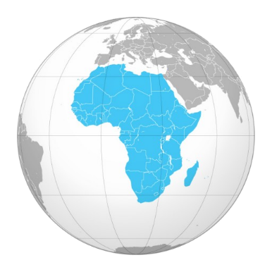
How much of the ocean seafloor have we mapped?
“95% of the ocean remains unexplored”
100% mapped at resolution of 5 km
10% to 15% mapped at resolution of 100 m
Notes:
If you want better resolutions at 100 meters, we have still have around 10% to 15% of our planet’s ocean mapped, which is around the size of Africa. And this is done by using SONAR techniques from ships sailing across the sea. However, that’s just the structural features of the seafloor, which we call Bathymetric features.

Slide 6
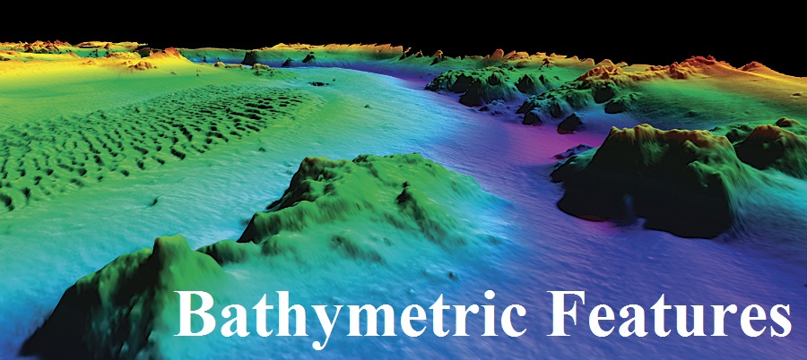
How much of the ocean seafloor have we mapped?
“95% of the ocean remains unexplored”
100% mapped at resolution of 5 km
10% to 15% mapped at resolution of 100 m
Notes:
That’s not really want we want to know. What we really want to know about are the types of habitat environments that exists at those seafloor regions. We call these Benthic Habitats.

Slide 7
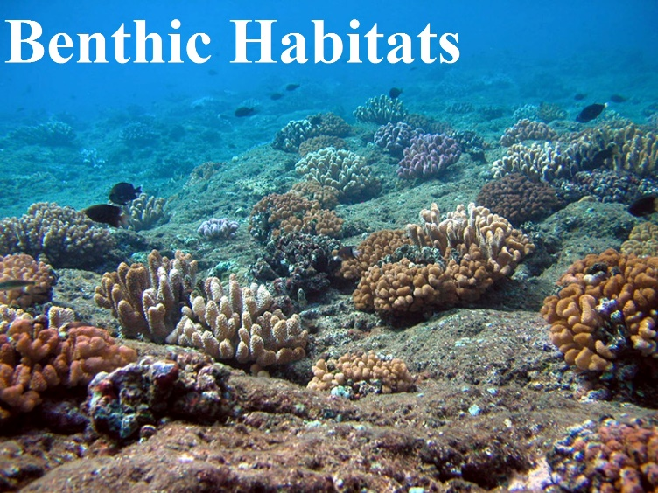
How much of the ocean seafloor have we mapped?
“95% of the ocean remains unexplored”
100% mapped at resolution of 5 km
10% to 15% mapped at resolution of 100 m
Notes:
So how much of THOSE regions have we actually visited?

Slide 8
How much of the ocean seafloor have we mapped?
“95% of the ocean remains unexplored”
100% mapped at resolution of 5 km
10% to 15% mapped at resolution of 100 m
Less than 0.05% actually visited!
Notes:
Surprisingly, only 0.05%! For a planet which is 70% covered with ocean, we really do not know much about the Earth’s most abundant type of habitats.

Slide 9

How much of the ocean seafloor have we mapped?
“95% of the ocean remains unexplored”
100% mapped at resolution of 5 km
10% to 15% mapped at resolution of 100 m
Less than 0.05% actually visited!
Notes:
This is why we deploy Autonomous Underwater Vehicles, or AUVs, to take pictures of those benthic habitats so that we can build a good map of it. But the problem is this. There is so much of the seafloor to explore.
Unlike using SONAR from floating ships, AUVs travel much slower underwater and are also more expensive due to the mission costs. They also run out of battery power every tens of kilometres. Basically, AUVs cannot map benthic habitats at the rate ships have mapped seafloor bathymetry using SONAR. This raises the question, how should we best explore the seafloor in order to map the benthic habitats under cost and time constraints?

Slide 10
Informative Seafloor Exploration
for
Benthic Habitat Mapping
Knowing the Bathymetry… which way should I go?
Notes:
My name is Kelvin, and today I would like to chat to you about informative seafloor exploration for benthic habitat mapping. The idea is for the AUV to focus on exploring the most ‘informative’ places so that the vehicle can obtain the most essential information regarding the seafloor so that it can map the benthic habitats more quickly. These is a form of an informative path planning problem. There are two parts to this thesis: the path planning part, and the mapping part. We will talk about mapping first.

Slide 11
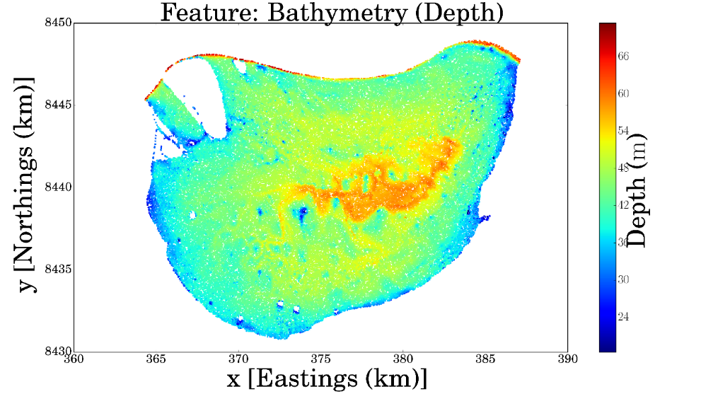
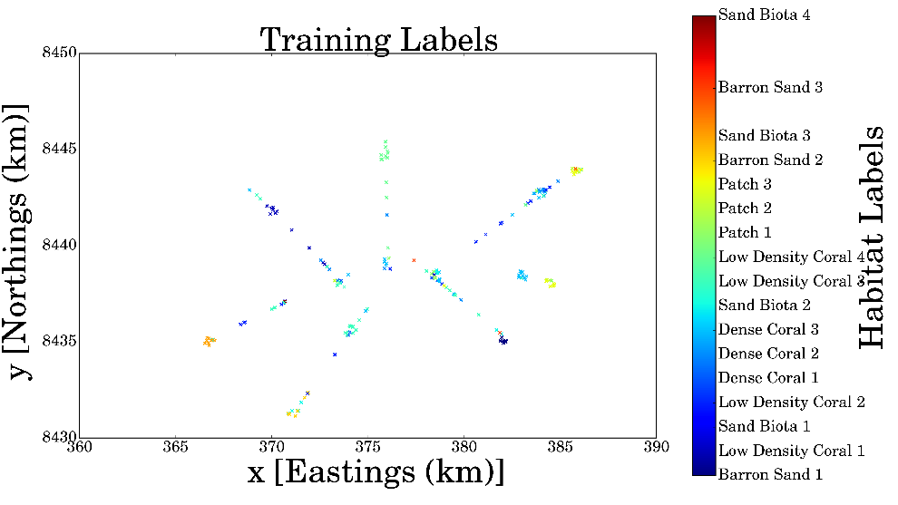
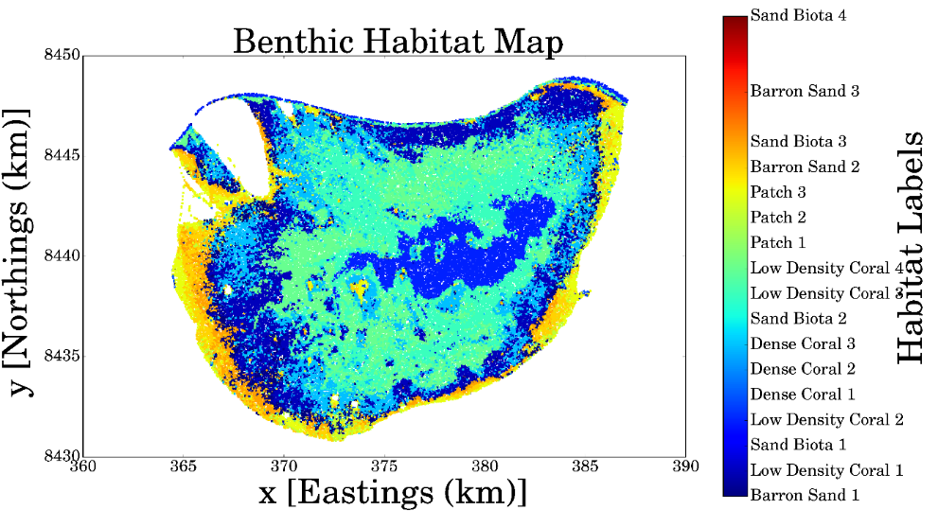
Benthic Habitat Mapping
Notes:
So the basic Benthic Habitat Mapping Problem is this. Here is an typical example using the dataset from Scott Reef, Western Australia.
We have plenty of observations

Slide 12
Benthic Habitat Mapping

Slide 13
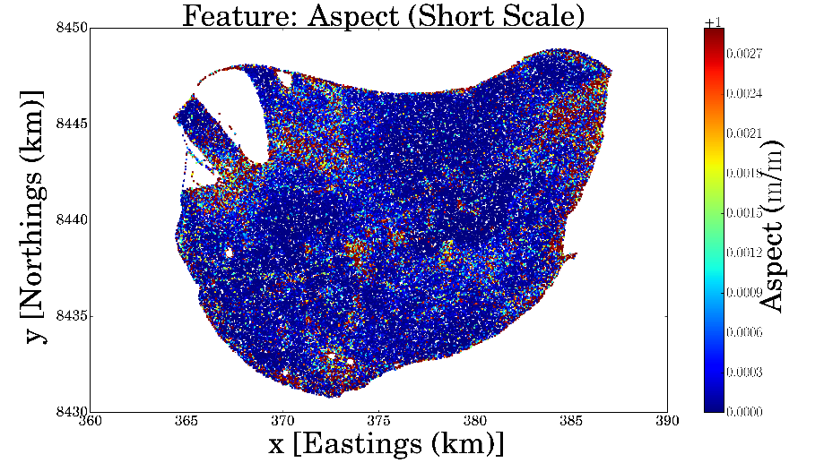
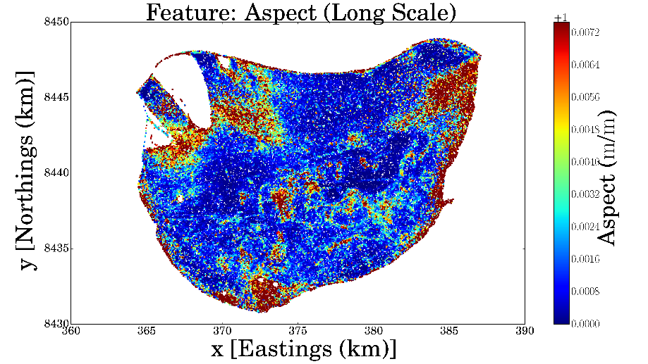
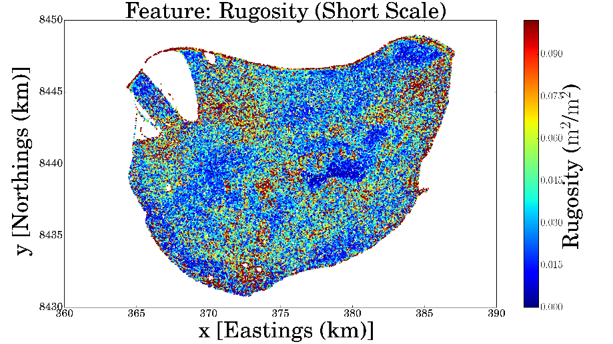
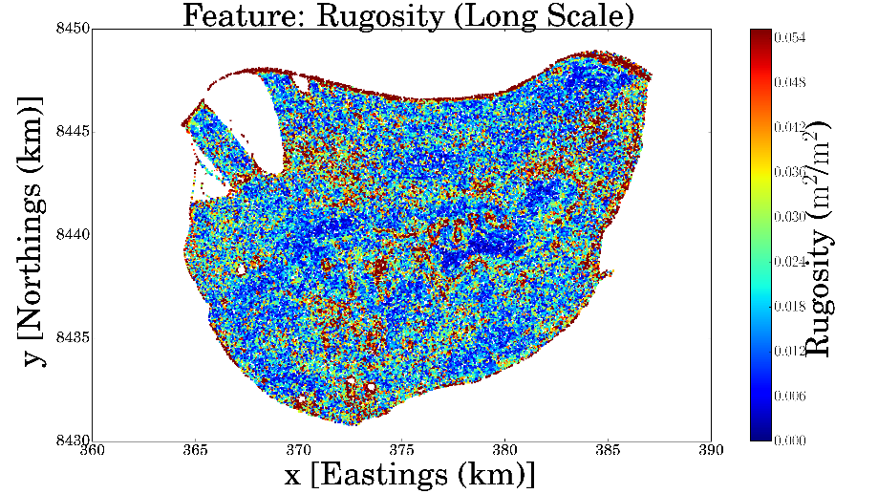
Benthic Habitat Mapping

Slide 14
Gaussian Processes for Bayesian Modeling
Bayesian and Non-Parametric Model
Flexible
Infinite dimensional extension of a multivariate Gaussian distribution
Notes:
-Gaussian process: Non-Parametric and Bayesian Model
-Explain “Bayesian” and “Non-Parametric”
It is a Stochastic Process that generalises the usual multivariate Gaussian distribution. In fact, it can be seen as an infinite dimensional Gaussian distribution. As such, it can be used to model functions, instead of just finitely many variables.
-Define a GP
-Prior/Posterior

Slide 15
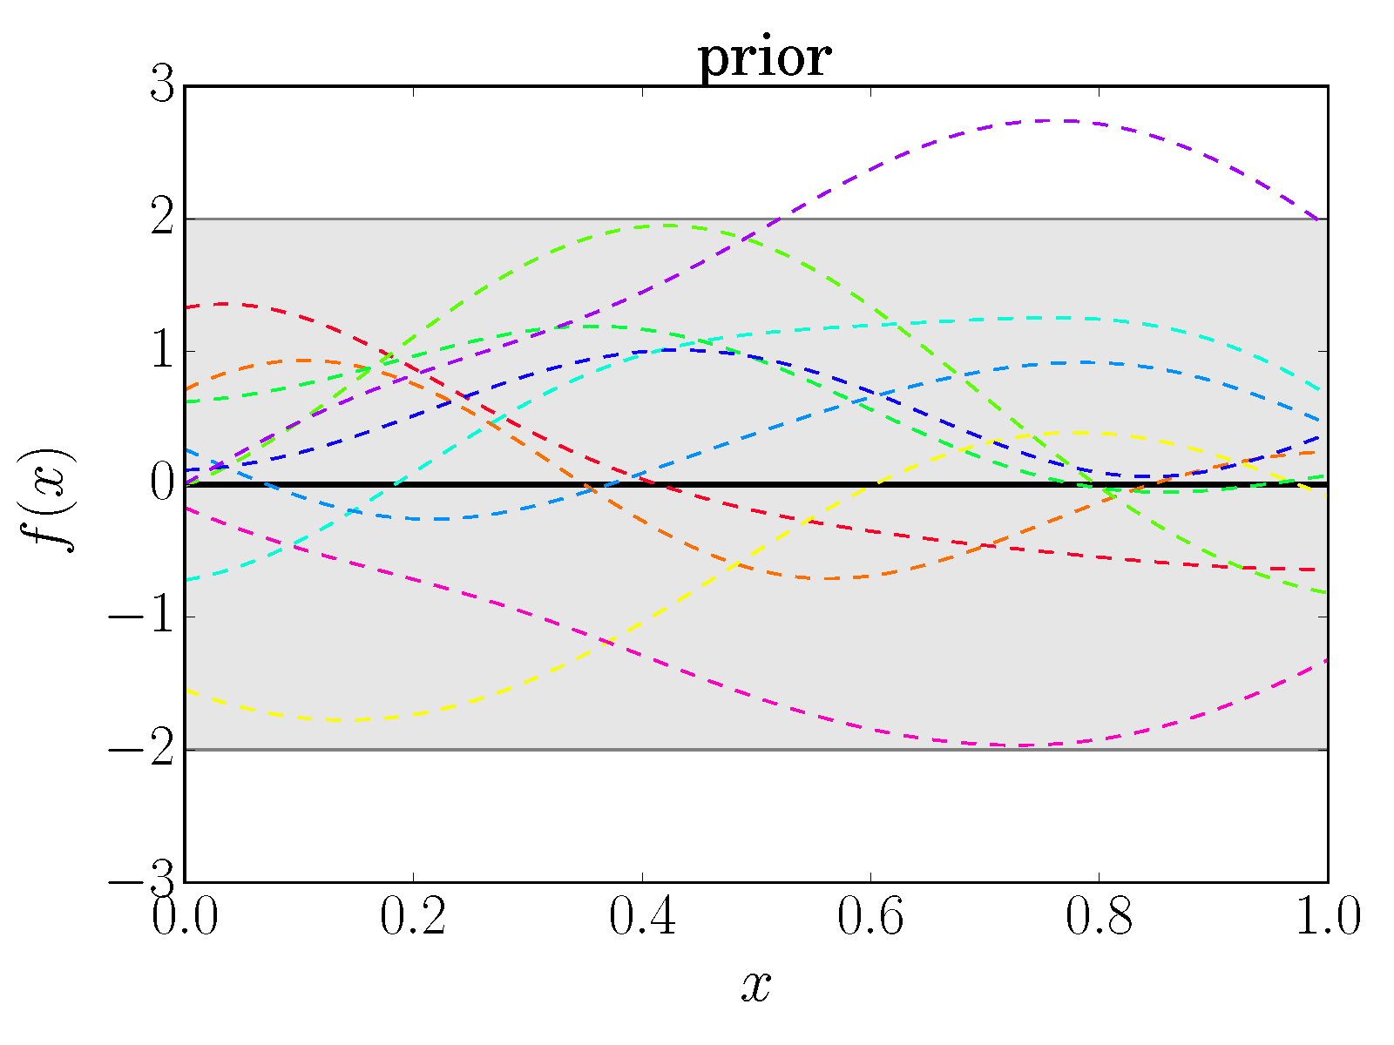
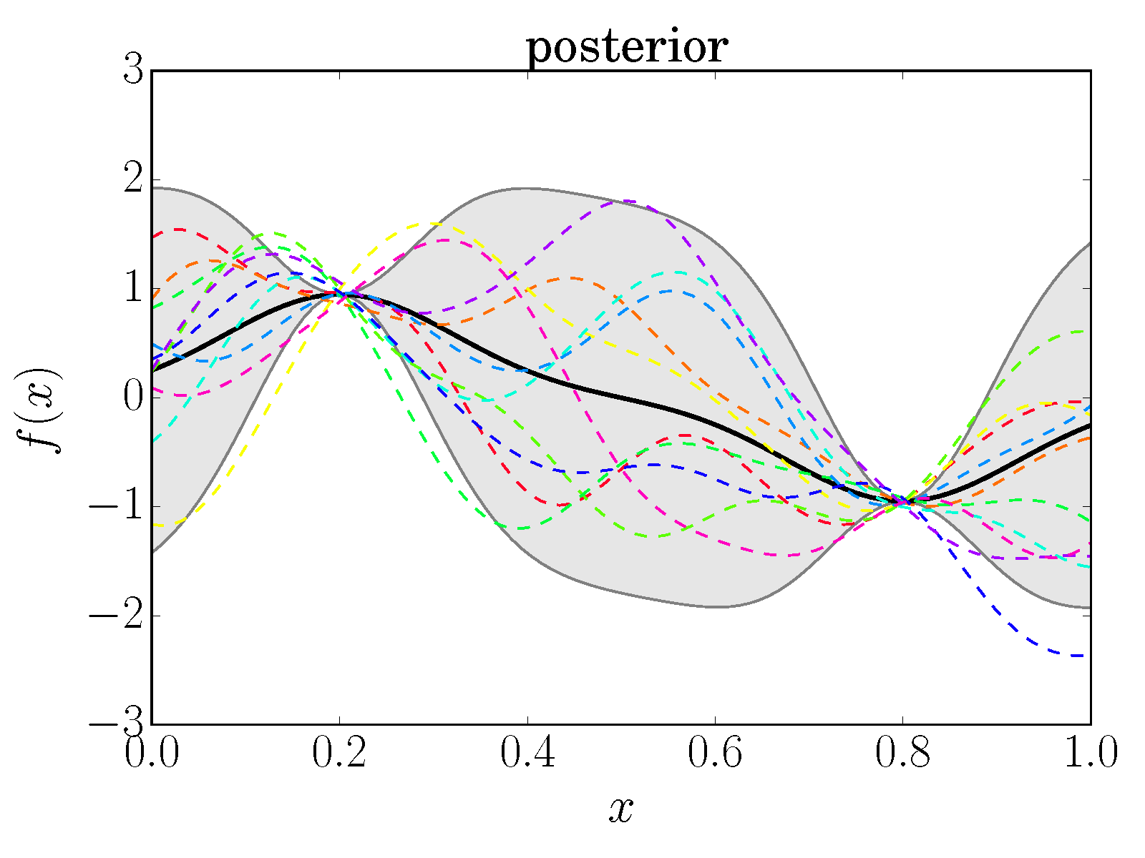
Gaussian Processes for Bayesian Modeling
Notes:
-Gaussian process: Non-Parametric and Bayesian Model
-Explain “Bayesian” and “Non-Parametric”
It is a Stochastic Process that generalises the usual multivariate Gaussian distribution. In fact, it can be seen as an infinite dimensional Gaussian distribution. As such, it can be used to model functions, instead of just finitely many variables.
-Define a GP
-Prior/Posterior

Slide 16


Gaussian Processes for Bayesian Modeling
Notes:
But wait!

Slide 17
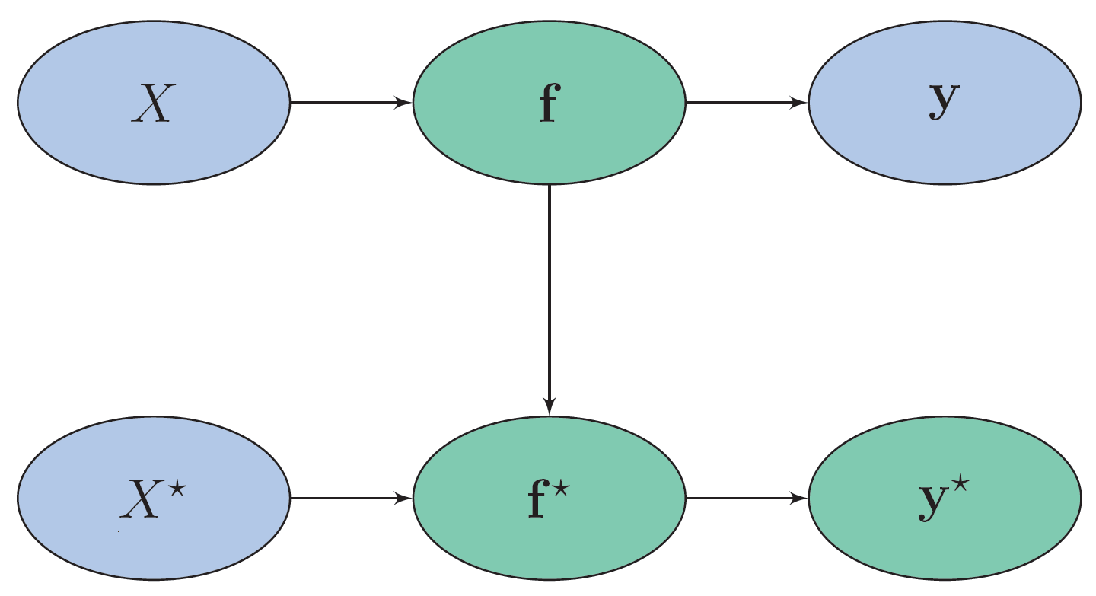
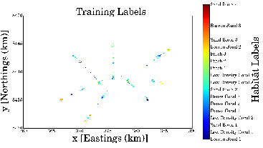
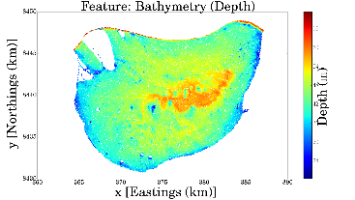
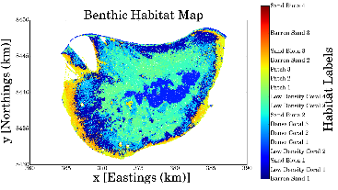
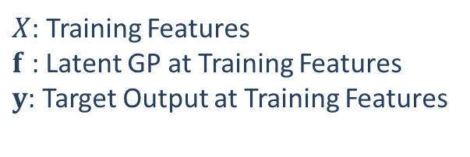
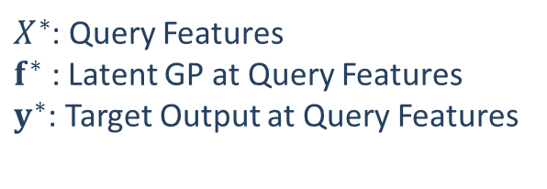
Gaussian Processes Classifiers
$X$: Training Features
$f$ : Latent GP at Training Features
$y$: Target Output at Training Features
Gaussian processes as an
intermediate latent function
$X^{∗}$: Query Features
$f^{∗}$ : Latent GP at Query Features
$y^{∗}$: Target Output at Query Features

Slide 18
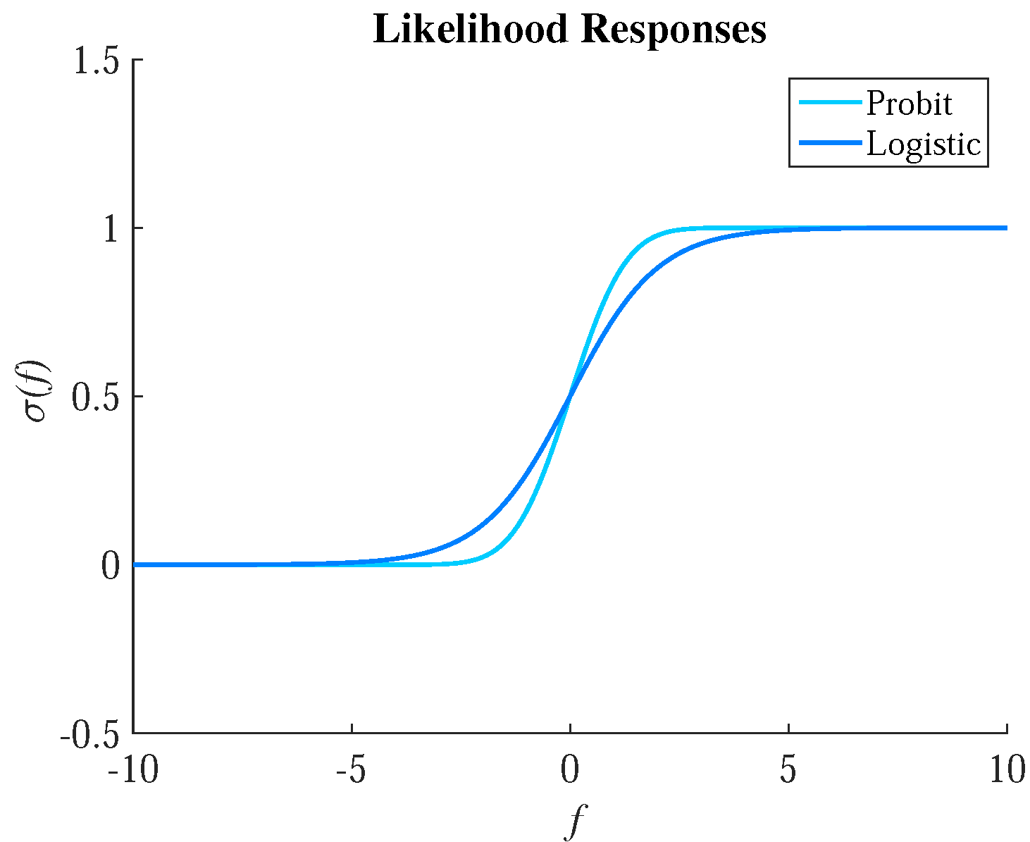
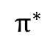
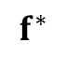
Gaussian Process Classifiers
$$f^{∗}$$
$$π^{∗}$$

Slide 19
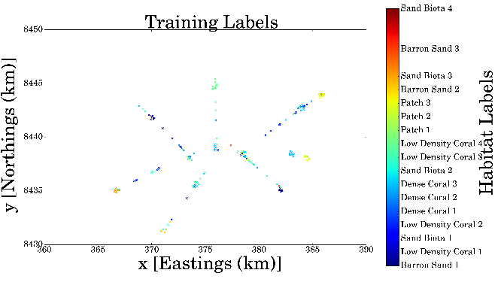
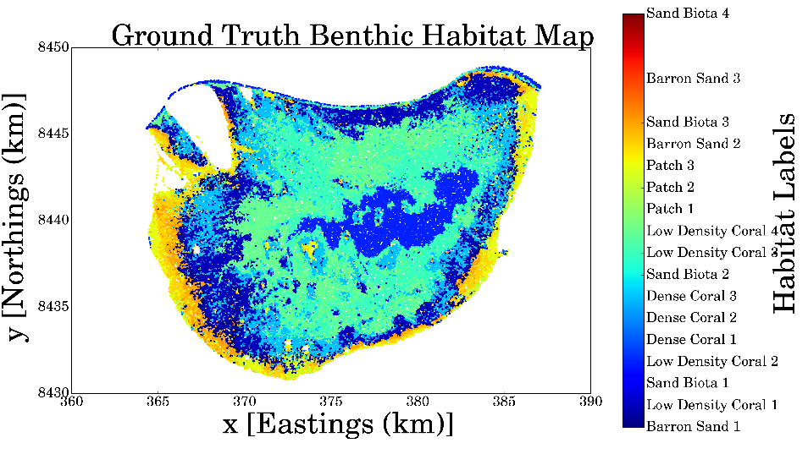
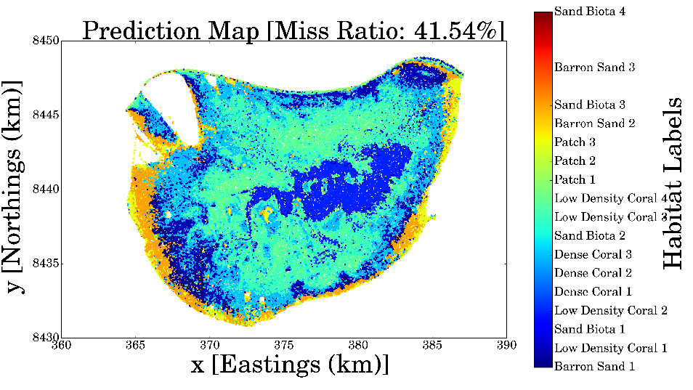
Mapping Benthic Habitats at Scott Reef
Ground Truth
Prediction of Benthic Habitats

Slide 20


Informative Seafloor Exploration: Acquisition Functions
Measures desirability of a candidate path
More Information -> More desirable
What is the best way to measure information?

Slide 21
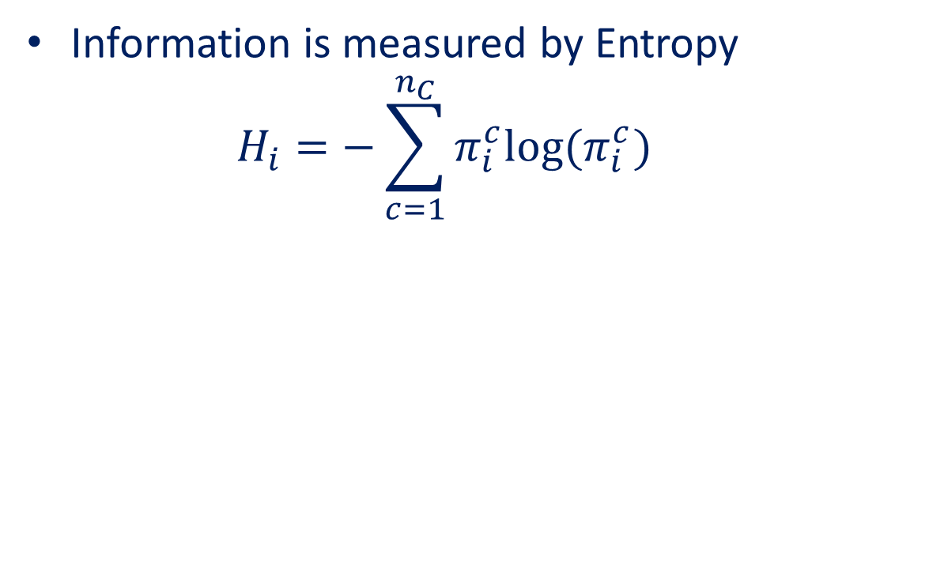
Informative Seafloor Exploration: Acquisition Functions
Information is measured by Entropy
$$H_{i}=−\sum_{c=1}^{n_{C}}{π_{i}^{c}log⁡(π_{i}^{c}) }$$

Slide 22
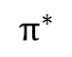

Informative Seafloor Exploration: Acquisition Functions
Information is measured by Entropy
$$H_{i}=−\sum_{c=1}^{n_{C}}{π_{i}^{c}log⁡(π_{i}^{c}) }$$
$$f^{∗}$$
$$π^{∗}$$

Slide 23
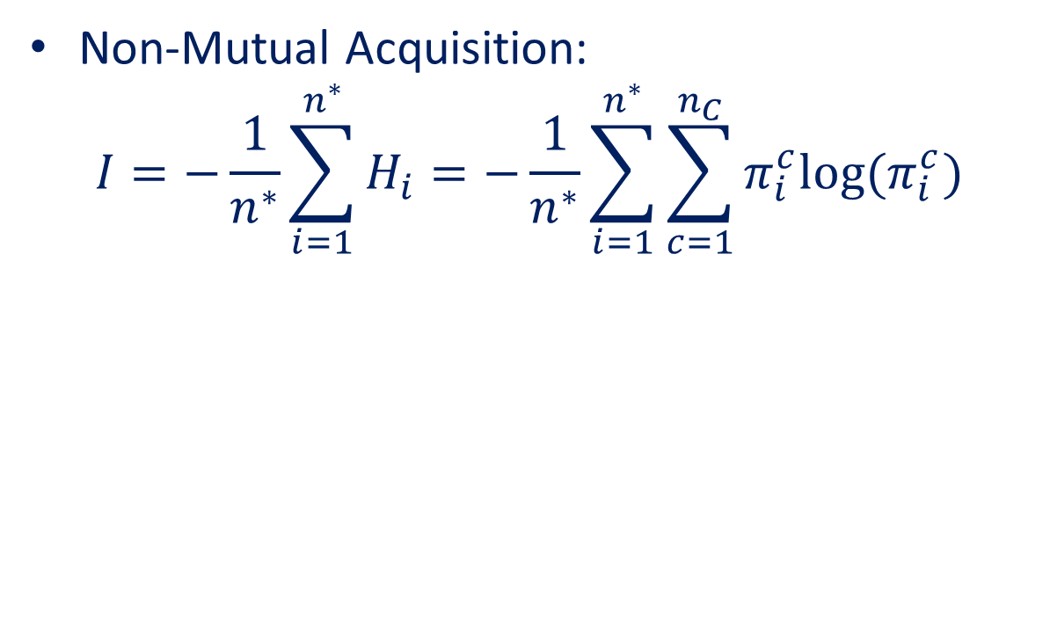
Informative Seafloor Exploration: Acquisition Functions
Non-Mutual Acquisition:
$$I=−\frac{1}{n^{∗}}\sum_{i=1}^{n^{∗}}{H_{i}}=−\frac{1}{n^{∗}}\sum_{i=1}^{n^{∗}}{\sum_{c=1}^{n_{C}}{π_{i}^{c}log⁡(π_{i}^{c}) }}$$
Has
Joint
Distribution
No Analytical
Joint Distribution
$$f^{∗}$$
$$π^{∗}$$
Monte Carlo?

Slide 24
Linearised Model Differential Entropy
Is the entropy of the prediction probabilities itself
Computationally faster and analytically tractable
Measures the ability to separate the classes
Able to handle uncertainty due to bias as well as variance
Has
Joint
Distribution
No Analytical
Joint Distribution
$$f^{∗}$$
$$π^{∗}$$

Slide 25
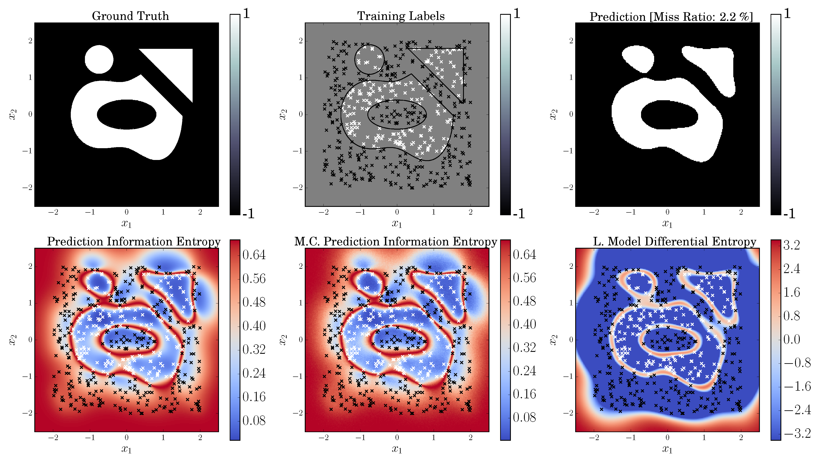
Prediction Information Entropy V.S. Linearised Model Differential Entropy

Slide 26
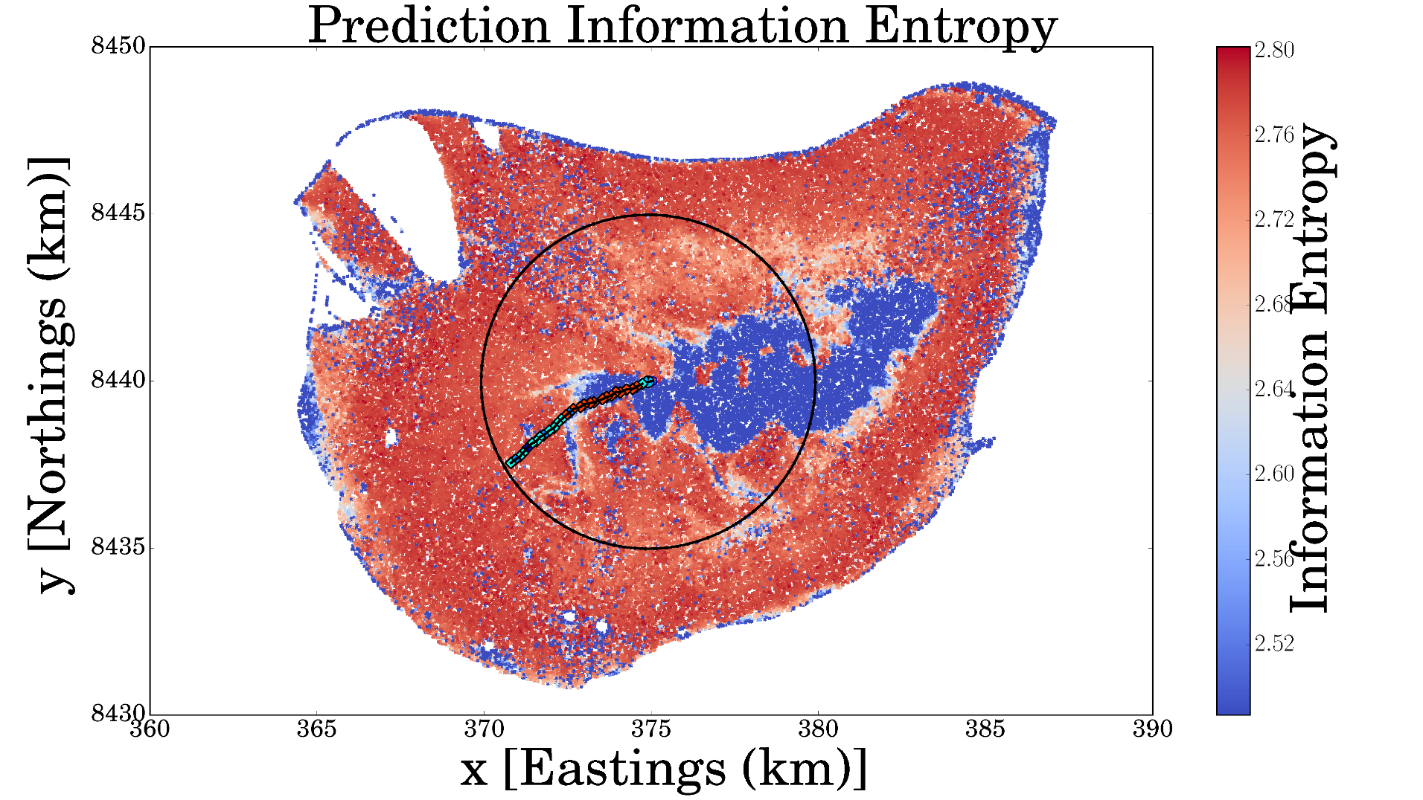
Receding Horizon Formulation

Slide 27

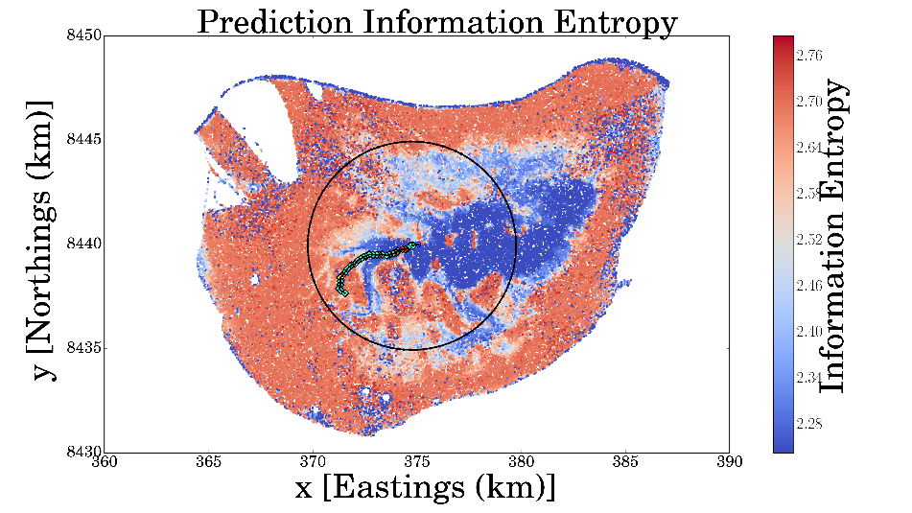
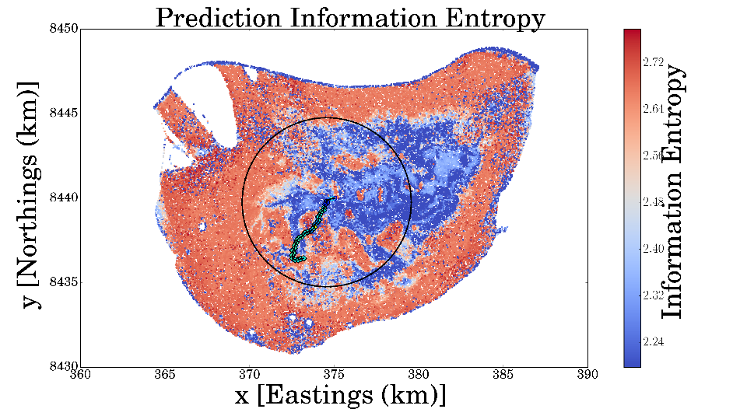
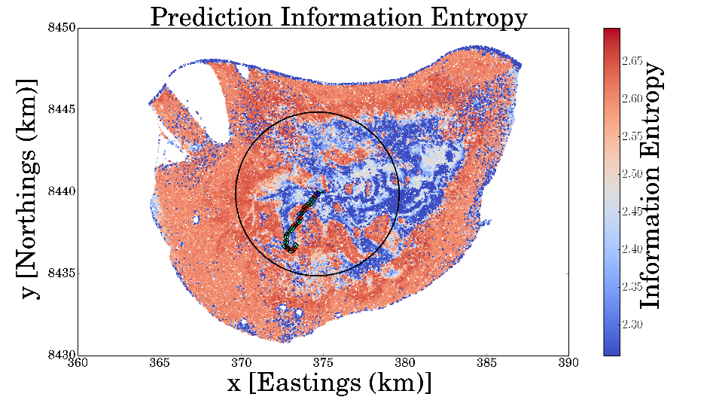
Receding Horizon Formulation

Slide 28
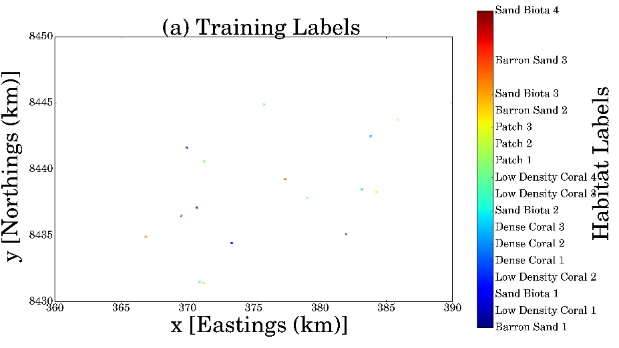
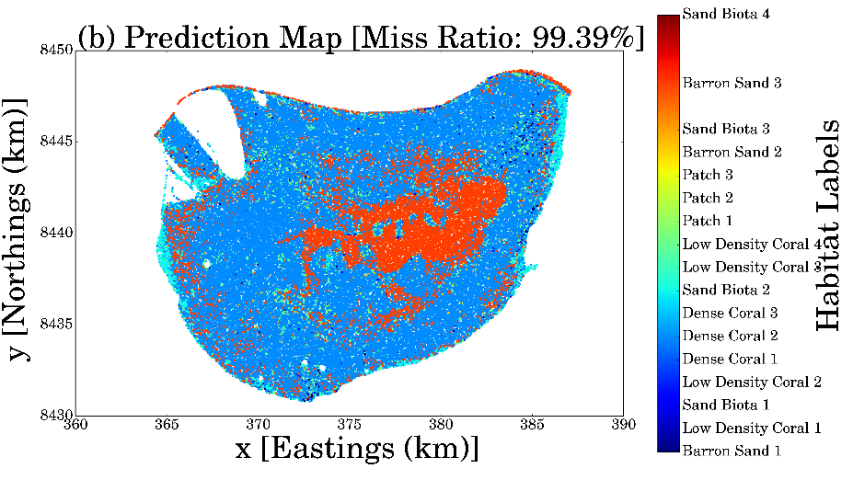
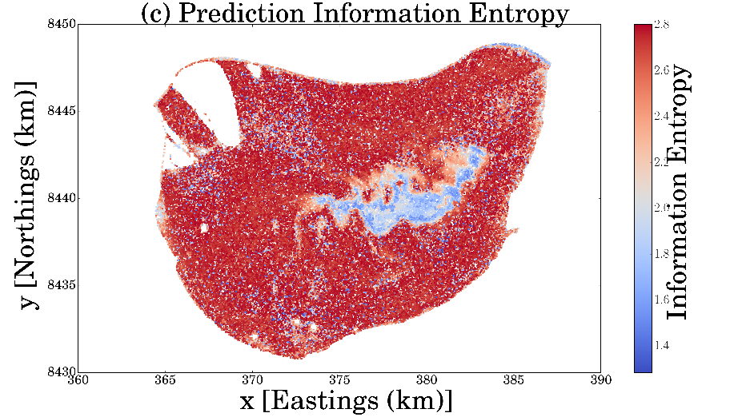
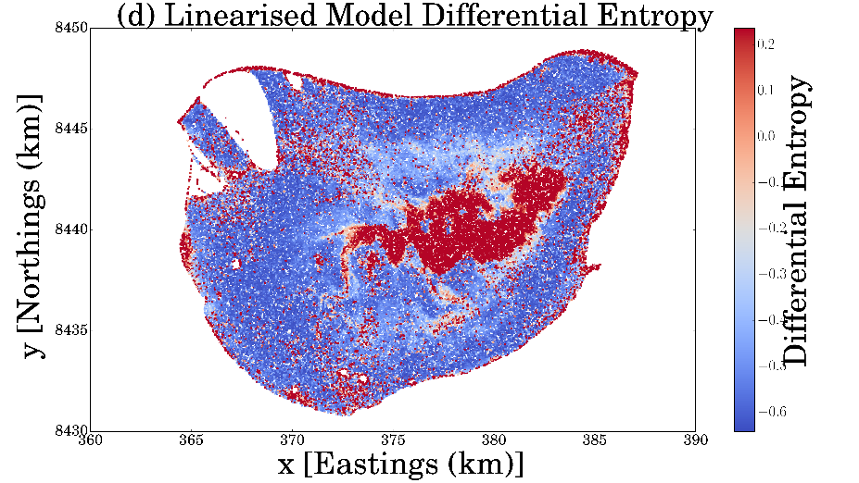
Initial Situation at Scott Reef

Slide 29
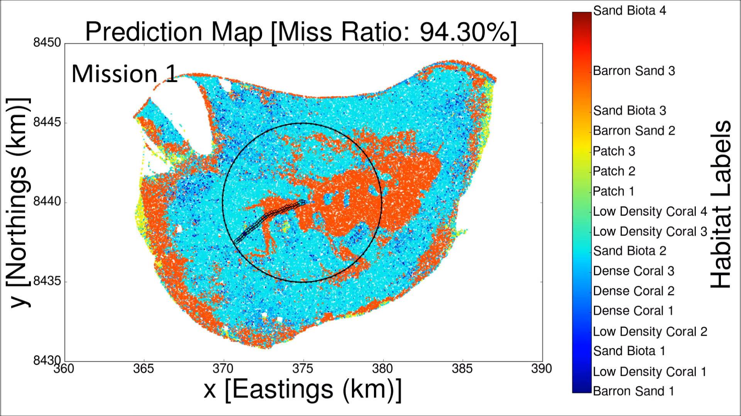
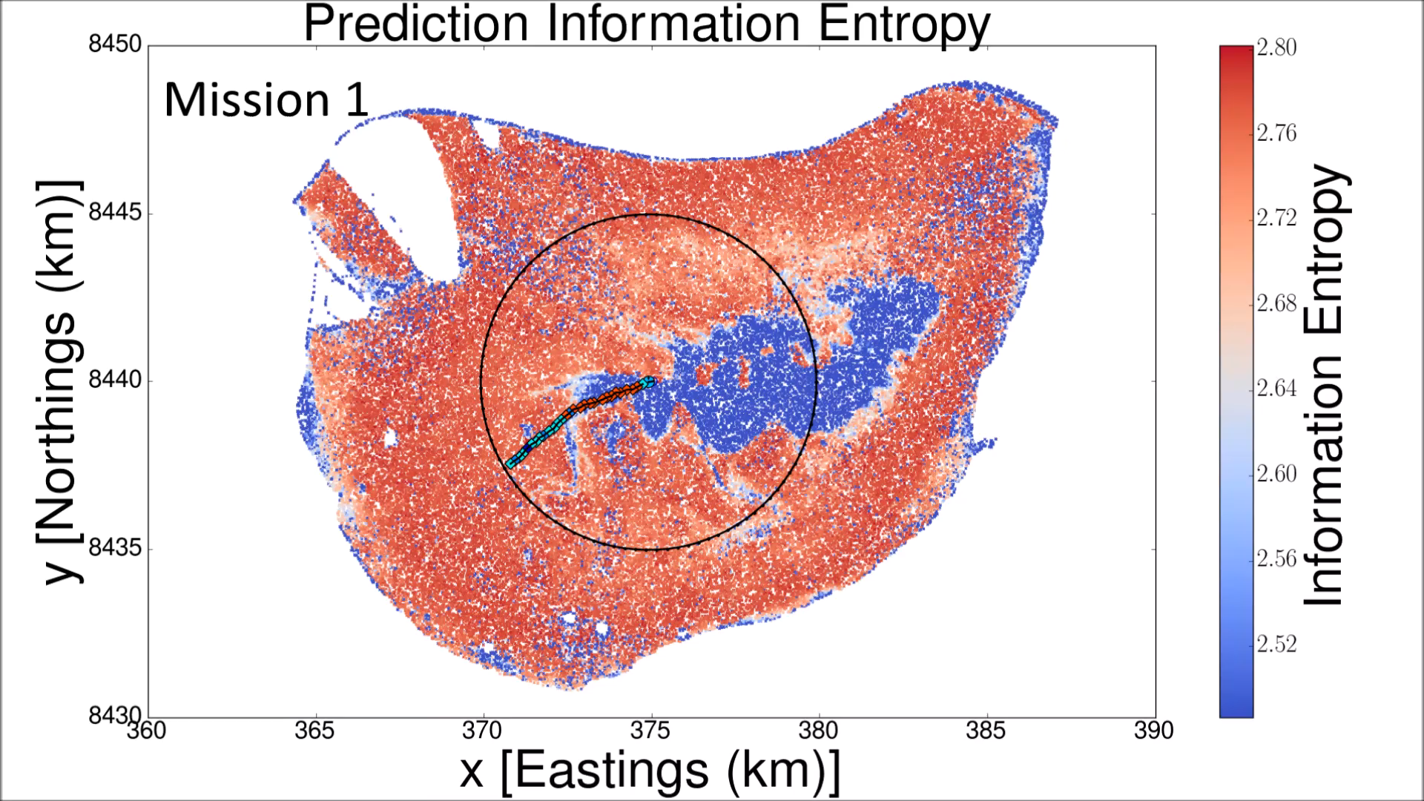
Informative Seafloor Exploration at Scott Reef

Slide 30
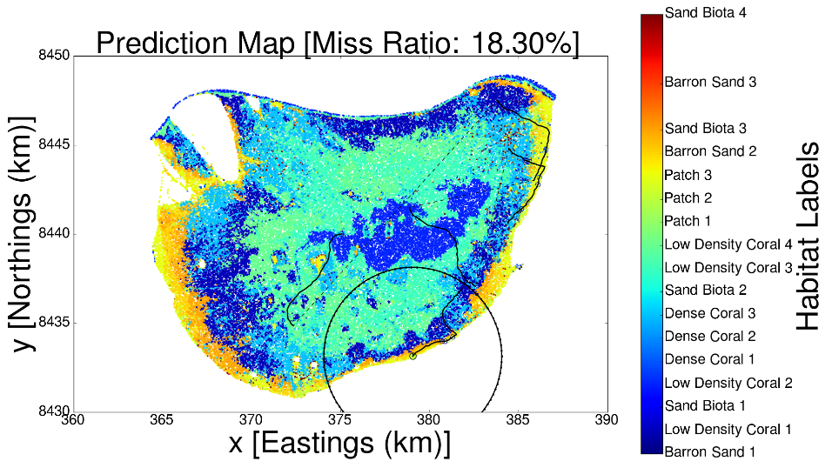
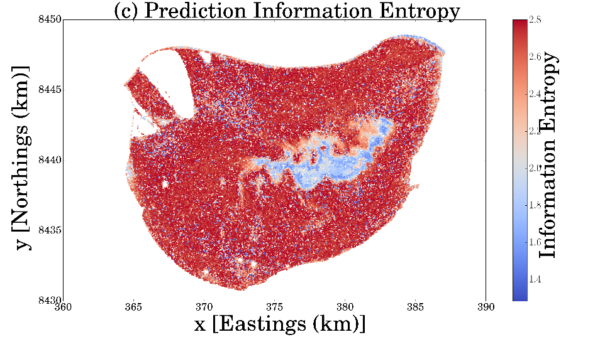
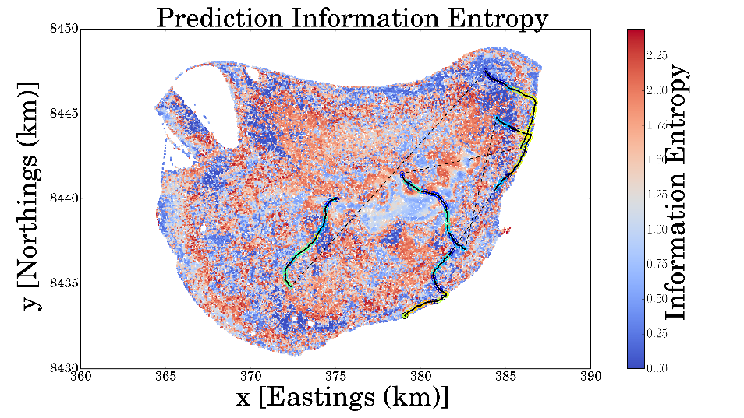
Informative Seafloor Exploration at Scott Reef

Slide 31
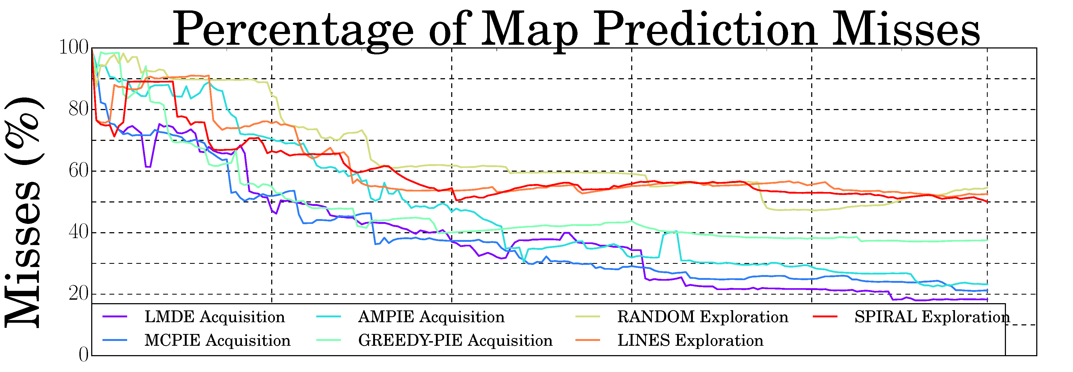
Informative Seafloor Exploration at Scott Reef
Policy | LMDE | MCPIE | AMPIE | GREEDY | RAND | LINES | SPIRAL
Informative | Yes | Yes | Yes | Yes | No | No | No
Non-Myopic | Yes | Yes | Yes | No | No | Yes | Yes
Mutual | Yes | Yes | No | No | No | No | No

Slide 32
Final Mapping Error (%) after five 6.6 km missions
Policy | LMDE | MCPIE | AMPIE | GREEDY | RAND | LINES | SPIRAL
Test 1 | 18.30 | 21.22 | 23.21 | 37.54 | 54.63 | 52.54 | 50.06
Test 2 | 16.44 | 22.99 | 32.11 | 43.86 | 34.87 | 20.40 | 33.74
Test 3 | 20.38 | 27.01 | 40.11 | 37.63 | 35.68 | 25.05 | 43.16

Slide 33
Final Mapping Error (%) after five 6.6 km missions
Policy | LMDE | MCPIE | AMPIE | GREEDY | RAND | LINES | SPIRAL
Test 1 | 18.30 | 21.22 | 23.21 | 37.54 | 54.63 | 52.54 | 50.06
Test 2 | 16.44 | 22.99 | 32.11 | 43.86 | 34.87 | 20.40 | 33.74
Test 3 | 20.38 | 27.01 | 40.11 | 37.63 | 35.68 | 25.05 | 43.16

Slide 34
Thank You!
Special Thanks to
Stefan Williams
Simon O’Callaghan
Alistair Reid

